Slide 1





Rust, Face Detection and a pair of Bongos
@Payne325
Alexander Payne
Payne325
PaynoInsano

Slide 2
Why?
I like to make small game prototypes
I wanted more experience with Rust
Face detection not explored by developers as much in recent years despite everyone having a camera
Bongos are an unusual form of input, interesting to work with

Slide 3

Rust
Computationally fast and memory efficient
Comparable to C++ in performance benchmarks
Designed to ensure memory/thread safety at compile time
Young language, so not as many pre-written libraries to utilise
Notes:
The first step was to download and install the library. For Windows this was recommended via a package manager, I used Chocolately. For Linux it's recommended for installation via the repository release or to compile from source.
Next I had to set a number of system variables. Most of these were documented but I ran into a few issues with certain system variables missing from the documentation. A number of issues in the repo suggested that this was not an uncommon problem. In fact there were a number of reported problems in the repo that I thankfully didn't see, but the build process certainly seems fragile on both Windows and Linux.
I couldn't help compare the process to that of opencv for python where you cna just install and setup everything via pip in one command.
Final step is to install the libclang-dev or llvm package depending on your OS. The crate depends on these for building.

Slide 4
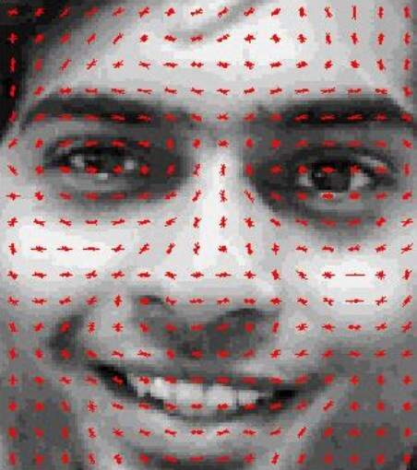
Approaches for Face Detection
Detect Facial Landmarks using H.O.G.s
Feature descriptors derived from distribution of intensity gradients within the image
Descriptors passed to a suitable ML model
Libraries offering HOG Face detection available for years
Can provide exact facial landmark position and head orientation
Notes:
- Detect Facial landmarks using HOGs (Histogram of Oriented Gradients)
- The idea is that feature descriptors can be extracted from an image, and these descriptors are derived from the distribution in intensity gradients within the image.
- The intensity gradient being a directional change in color intensity for a neighbourhood of pixels in an image. A descriptor is a concatenation of these.
- Descriptors are passed through some machine learned model to find the key facial landmarks (using H.O.Gs is fairly agnostic with regards to the model type)
- I believe that Support-Vector Machines were the first model used when H.O.G. facial detection although I've lost the link to wherever I read that, so citation needed.
- This functionality has been available via libraries such as dlib for many years, and the approach is known to work well.
- This method can produce information to generate the exact position of particular facial features, as well as the pose (orientation of a face).
- Understandably this can be rather computationally expensive (at least for a game), and we don't really need this much information for our simple game.

Slide 5
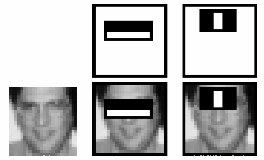
Approaches for Face Detection
Haar-feature classifier
Haar-feature is a predefined kernel used to detect lines and edges of contrasting intensity
Haar-feature classifier groups these into 'stages' and applies them to windows of the image
Windows passing all stages contain a facial landmark
Notes:
- Describe Haar-Feature classifier approach
- I discovered this after implementing my chosen approach, so did not consider this at the time.
- A predefined kernel/small matrix called a Haar-feature is applied across an image to detect the liklihood that some facial feature is within a particular subsection/window of the image.
- Haar-features are used to detect lines and edges where a face would contrast locally between a darker and lighter areas. E.g. eyes vs bridge of the nose.
- A Haar-feature classifier is a program constructed to group Haar-features in terms of priority into different stages and apply each stage to a window. If a stage fails, i.e. if it doesnt detect its desired haar-features, then the window is no longer considered for further evaluation. A window that passes all stages contains a facial landmark of some sort.
- This is very fast, but from my reading it only works well for faces facing directly front.
- OpenCV provides Haar-cascade Detection via its interface and even provides a weights file within its release files.
- If I revist this project, I'd like to experiment with a Harr-feature based implementation of the face tracker.

Slide 6
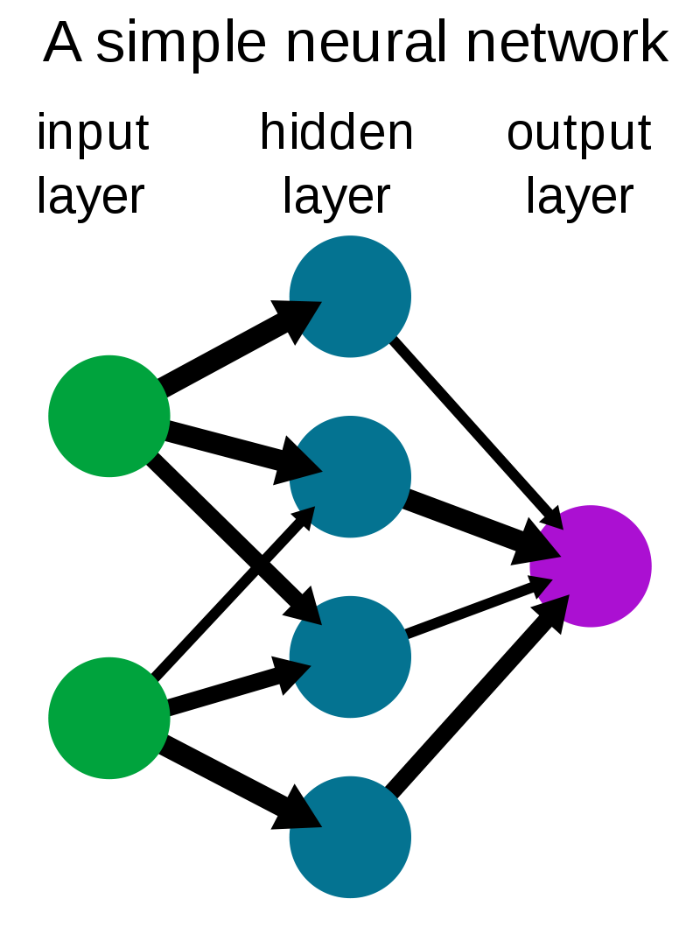
Approaches for Face Detection
Pass image through a Neural Network
Network of layers which uses weights to manipulate input data
During training, the layer weights are adjusted to provide the desired output
To detect a face, we can feed in pixel data and get image location
Notes:
- Describe DNN approach
- I'll admit to some bias for this approach, I had used it before with Python when first experimenting with OpenCV a few years ago
- For those that don't know, a neural network is a network of layers, each of which uses a series of weights to manipulate some given input data.
- When training a Neural Net, the result (in our case a classification) is determined as right or wrong, and that information is fed back into the model to adjust the weights at each layer.
- For face detection, we can feed in the pixel data of an image and have the model return an area supposedly containing the face.
- OpenCV has a Deep Neural Network (DNN) Module, with an interface for loading a caffe model and weights.
- It also hides the necessary model and weights for face detection in the source, which is now widely known online.
- This approach is very fast and doesn't require the user to be directly front facing.
- This approach avoids the need to determine/define any facial landmark descriptors, but we can only obtain a bounding box around the face instead of precise detection of the face
- Acceptable for our purposes
- Picked NN because
- prior experience
- had the model and weights to hand
- believed it would be mroe performant when running (best option for a game).

Slide 7
Bongos
Genuine Nintendo Donkey Konga Bongo Controller
Official Nintendo Gamecube to USB adapter from Sm4sh
Lots of documentation for using them online
  Unix based OS: Plug and Play
  Windows requires installation of unofficial driver
Bongo pad's map onto traditional Gamecube face buttons
Unable to pick up input from the clap sensor

Slide 8
How does it all work together?
Obtains an image frame from the camera
Image passed into neural network
Neural Network returns a bounding box, representing a box on the image that contains a detected face
Transform bounding box from image space to game space
Get box centre
  Use its X component as the player's position along X axis
Bullets created when player hits a bongo drum
Enemies spawned at top of the screen
  Spawn rate increases as time increases
Notes:
- Runs in a loop, starts by obtaining an image/frame from the camera
- Currently the program just grabs the first registered camera device, but could be extended to allow for other options.
- The image is then pre-processed into the size expected by the Neural net and converted to a 'blob'
- The image blob is passed to the Neural net as input data and a forward pass of the model is triggered. Meaning the image data is passed through the layers
- The output is returned in the form of a matrix, which we can extract normalised positions within the image to determine a bounding box containing the face.
- Simply multiply those normalised positions by the orginal frame width and height to obtain the position in the original image.
- Some of these points seem like they are quite complicated to do, and it can seem like I've glossed over them here, however each bullet point really only corresponds to one or two opencv functions, the library does a good job of extracting the complicated stuff across all available interfaces.

Slide 9
Was development a success?
Works as designed
Lots of fun... until I whacked my knee
Surprises learned from playing:
  Hadn't considered the role distance from camera would play
  The bounding box is much smaller when the player is further away from the camera
  Leads to interesting changes in control feel
  Calibration routine could be used to ensure consistent movement. Would account for various cameras and physical positions of a player
Notes:
It works! I was able to write a face detection program with Rust and it works quite well.
- Many of the crate's functions returned values wrapped in Rust's result type, which prompted me to write matches, causing the code to end up looking a bit like try/catch blocks.
- The C++ opencv lib is known to work well and is quite safe, so the rust binding to it is also performant.
- For the most part, the functions were a one-to-one mapping with the C++ implementation, made navigating documentation much easier
- Overall I'd say its extremely feasible to port an OpenCV based application from Python/CPP to Rust.

Slide 10
Lessons Learned
Rust:
  Fast
  Guarantees memory safety at compile time
  Community is young
  Not many fully developed/mature libraries for use
Face Detection for games:
  Multiple ways of detection faces, with various accuracy vs speed trade-offs
  Neural Network approach excellent for 2D movement
  Without using a pre-made model, gathering enough data to train your own model could be difficult
Notes:
However it wasn't all fun and games, in addition to the difficulty I encountered with the crate set up I also found a few problems during development.
- Although it was mostly pretty good, the interface was not entirely consistent across the Rust/CPP/Python versions. Particular example, giving an empty string when requesting a layer means all in cpp/python, in rusty it means none. This was not documented.
- OpenCV's interface has specific types for Input/Output to and from functions, which the auto generated bindings for Rust made somewhat overly complicated when converting these types to traits by obscuring the underlying type.
- For example, the OutputVector trait was used for vector and collection of vectors, meaning it got very confusing figuring out how many dimensions I had to deal with in my data source.
- I also found that end result was a program very coupled to the design of the neural network, which resulted in
- Necessary casting of output data
- Had to hard code the indices for extracting positional info from resultant matrix.
- It's worth noting that these are not necessarily failings of Rust, as these problems would exist wih Rust/CPP/Python. The Rust syntax did make these problems very obvious to see.

Slide 11
Lessons Learned
Bongos:
  They're fun to slap
  Software developers like to write libraries to support Bongo controllers early on in a programming language's life.
  Official adapter probably doesn't support the clap sensor
Camera Based Gameplay
  Calibration routine necessary for a polished product
  For fast paced gameplay, you need plenty of space
  It's relatively straightforward to implement camera based controls into game

Slide 12
Is it actually fun?
Hard to get others to try out the game
Bongo Controllers aren't commonly owned
That's where you come in...

Slide 13
Questions?
References available in accompanying notes
@Payne325
Alexander Payne
Payne325
PaynoInsano

